Slide 1
Database Management Project:
Student Scholarship Finder Application
Group 6: Xiuyi Feng, Massiel Sanchez

Slide 2
Project Statement
Scholarships and financial aid are important resources for many college students, particularly those from low-income families. Despite the numerous scholarships and financial aid options from federal, government, and other organizations, many students are unaware of their eligibility or even the existence of these aids. To address this, we propose the Smart Scholarship and Financial Aid System, which aims to streamline the scholarship and financial aid discovery and application process for students in the City University of New York (CUNY) system.
Using student data, the system will filter and suggest scholarships that align with each student's eligibility. Detailed information about each scholarship including its requirements, along with a direct application link will be provided to the student.

Slide 3
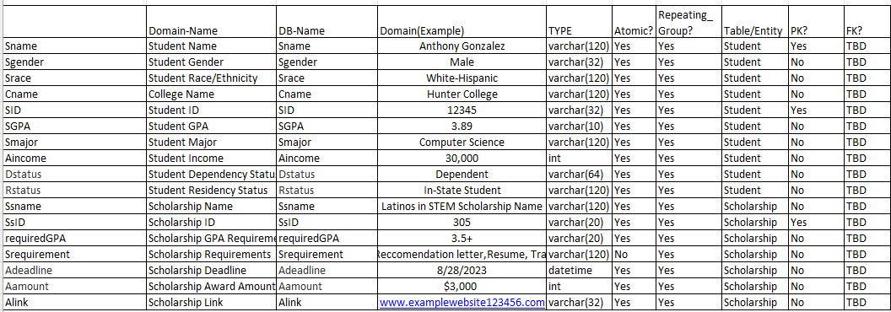
Attributes
The dataset includes comprehensive information about students including their names, gender, race, major, student ID, and more. Additionally, the dataset includes information about various scholarships for which the students may qualify for, including the scholarship names, requirements, deadlines, and other relevant details.

Slide 4
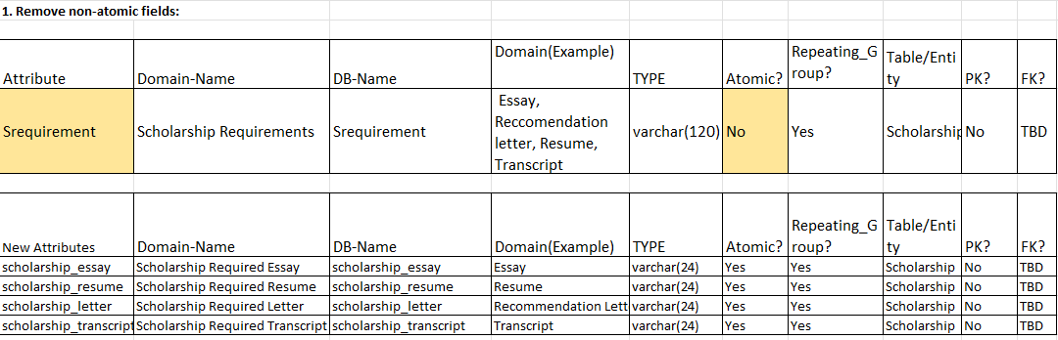
Normalization
To achieve first normal form (1NF) we must
Remove Non-Atomic Fields
Remove Repeating Groups
Find PK
In our attribute catalog the only non-atomic field was ‘Srequirement’. To remove the non-atomic attribute we converted the multi-domain attribute into multiple atomic attributes, each referring to a single domain.

Slide 5
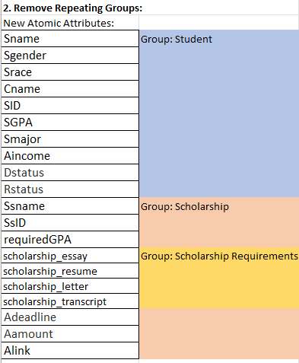
Normalization cont.
We identified three repeating groups in our new list of attributes: Students, Scholarships and Scholarship Requirements. To remove the repeating groups we grouped the related fields into separate tables.

Slide 6
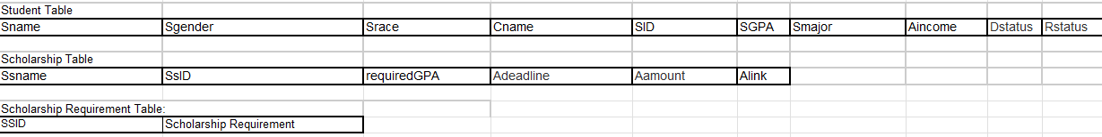
Normalization cont.
separate tables for related entities

Slide 7
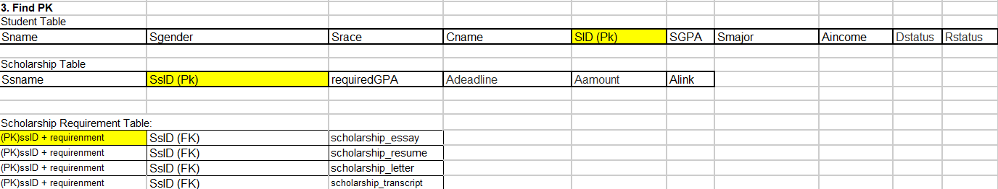
Normalization cont.
Finally, we identified the primary key of each table. The Student table uses the student ID, the Scholarship table uses the Scholarship ID and lastly, a composite key consisting of the scholarship Id and specific scholarship requirement is the key of the Requirement table.

Slide 8
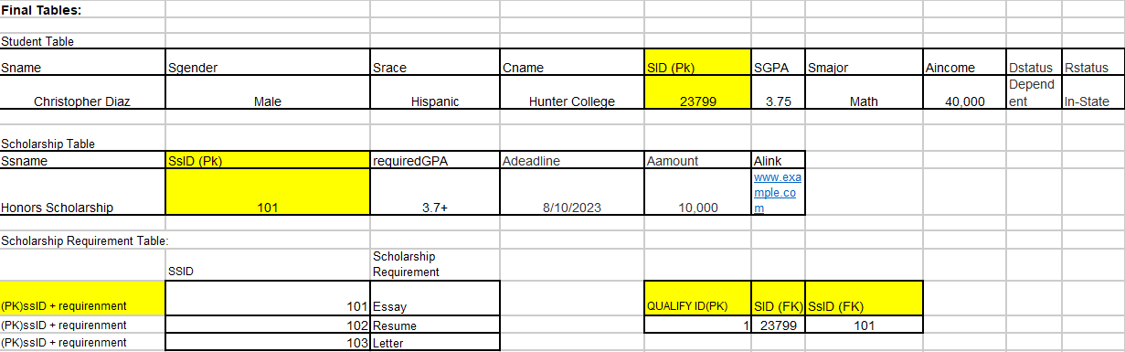
Normalization cont.
To achieve second normal form (2NF), partial dependencies must be removed. After performing 1NF, we did not identify any partial dependencies. All attributes within their respective tables rely entirely on the complete primary key.
Further, to achieve third normal form (3NF), we have to eliminate transitive dependencies. Our tables had none.

Slide 9
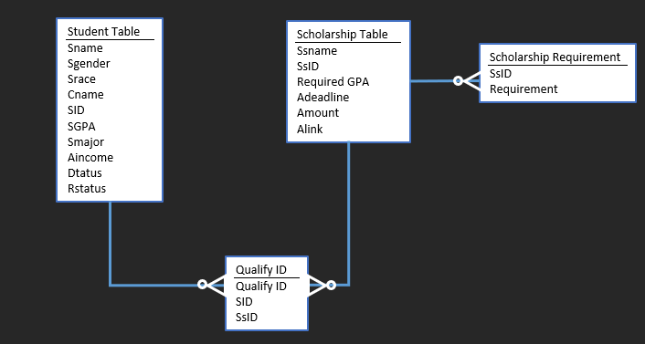
ERD - Crowfoot Notation
Cardinality Statements
1 Student can qualify for zero or more Scholarships. Each qualification corresponds to a single student. Zero or one to many
1 Scholarship can be awarded to zero more students. One scholarship can be qualified for by many students, but each qualification is specific to a single scholarship. Zero-or one to many
1 Scholarship can have zero or more requirements

Slide 10
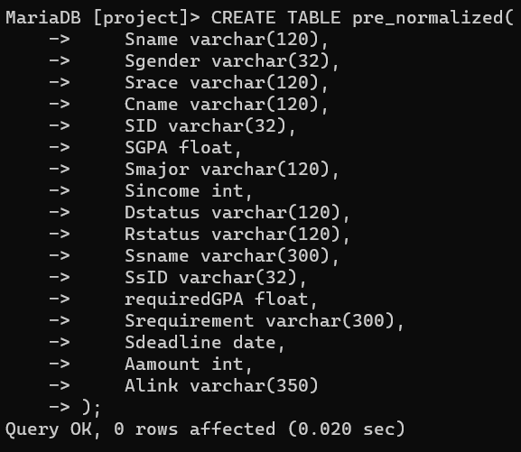
Pre-normalization Table Definition
*This SQL DDL statement defines the pre_normalized table

Slide 11
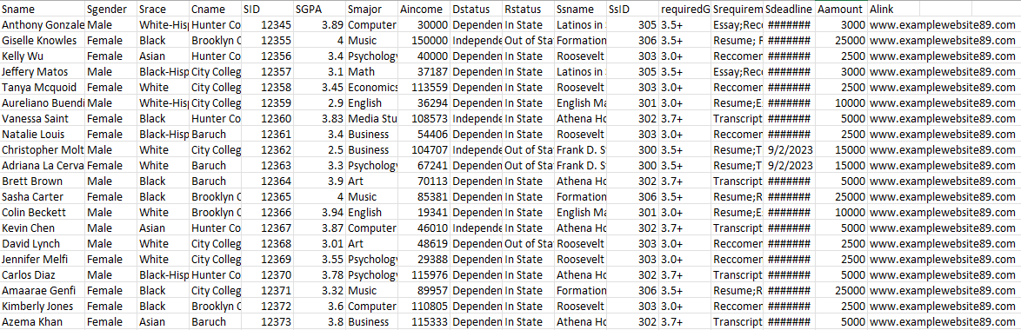
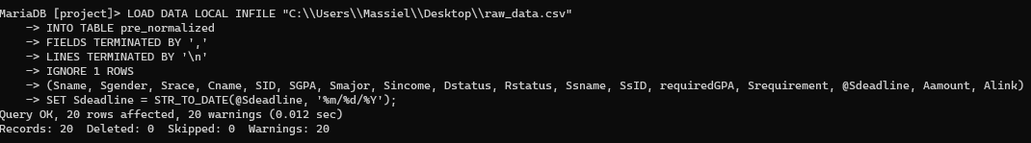
Loading Raw Data From CSV file
dummy data in csv file
Loading data into pre_normalized table. Had to change the format of the date data in column ‘Sdeadline’.

Slide 12
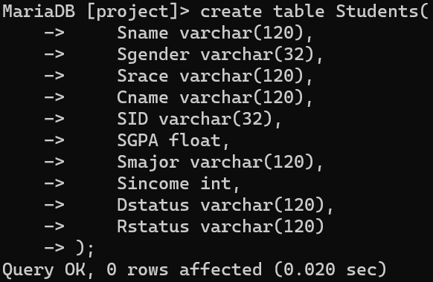
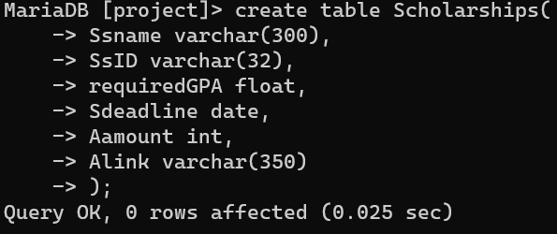
DDL Statements of Normalized Tables
*This SQL DDL statement defines the Students table
*This SQL DDL statement defines the Scholarships table

Slide 13
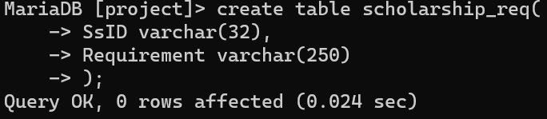
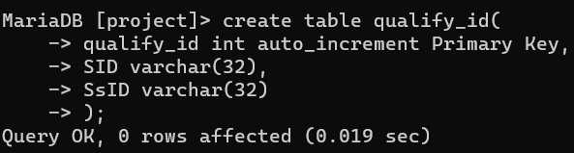
DDL Statements of Normalized Tables
*This SQL DDL statement defines the scholarship_req table
*This SQL DDL statement defines the Qualify_ID table

Slide 14
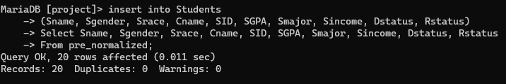
Loading Data into Normalized Tables
Loading data from pre_normalized table into the students table:

Slide 15
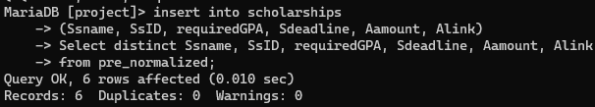
Loading Data into Normalized Tables
Loading data from pre_normalized table into Scholarships Table:

Slide 16
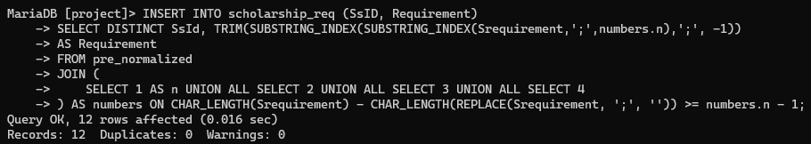
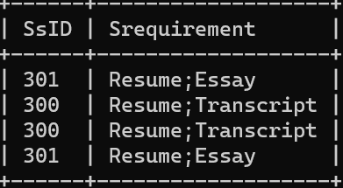
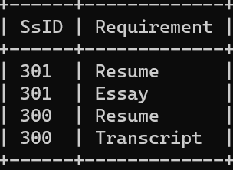
Loading Data into Normalized Tables
Loading data into the scholarship_req table:

Slide 17
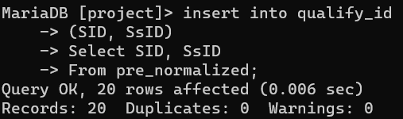
Loading Data into Normalized Tables
Loading data into the qualify_id table:

Slide 18
Possible Queries
Find Students with certain GPAs or Majors
select * from students where 3.5 < SGPA;
select * from students where Smajor = ‘Math’;
Return Scholarship IDs that a Student is eligible for using qualify_id table
select q.SsID, stu.Sname, stu.SID from qualify_id q join Students stu on q.SID = stu.SID;
Return requirements of Scholarship student is eligible for given Scholarship ID
select * from scholarship_req where SsID = 'xxx’;
Return requirements of scholarship student qualifies for
select * from scholarship_req req natural join (select q.SsID, stu.Sname from qualify_id q join Students stu on q.SID = stu.SID) qualify;
Return scholarships with required GPA 3.5+
select * from scholarships where 3.5 <= requiredGPA;

Slide 19
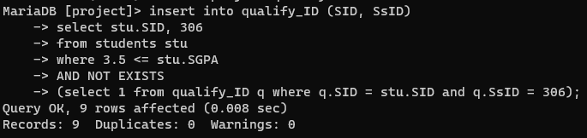
More queries
Return Students with GPA greater or = 3.5
select * from students where 3.5 <= SGPA;
Add students that qualify for certain scholarship into qualify_ID table

Slide 20
Acknowledgements
ChatGPT and other online resources were used to resolve errors

